Slide 1
Data Science with Kaggle Decal Keras and CNNs
Instructors: Jerry Chen, Joseph Simonian, Phillip Kuznetsov
Website: https://kaggledecal.github.io
Github: https://github.com/kaggledecal/kaggle_fa16
OH: See Piazza
Sign-In: [See board]
Fall ’16

Slide 2
Keras
Really awesome Deep Learning Library
Makes building Neural Network architectures really easy
Compiles to TensorFlow or Theano
Notes:
Keras is a really great tool to get your deep learning projects off the ground.
Building a network in Keras is really easy.
You just need to define the model, then define what optimization technique you want and you’re done
It’s great because you can also choose the backend deep learning framework you want to use.
Tensorflow and Theano will probably continue to try and out perform each other, so why not avoid the compromise – chose both

Slide 3

Keras
Notes:
Keras is a really great tool to get your deep learning projects off the ground.
Building a network in Keras is really easy.
You just need to define the model, then define what optimization technique you want and you’re done
It’s great because you can also choose the backend deep learning framework you want to use.
Tensorflow and Theano will probably continue to try and outperform each other, so why not avoid the compromise – chose both

Slide 4
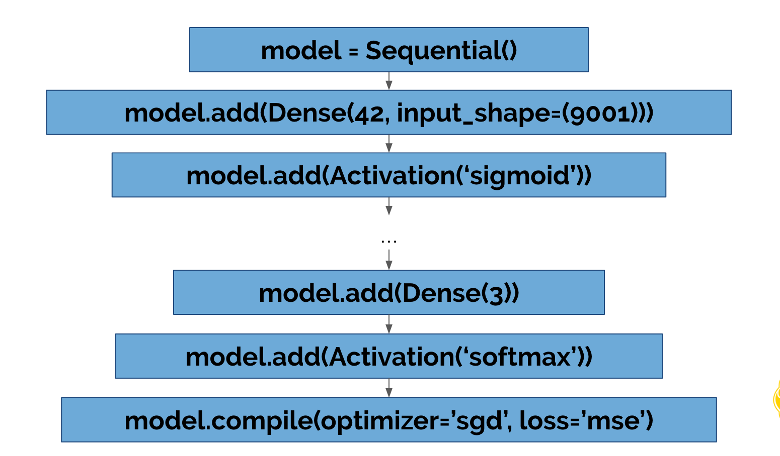
Keras
Notes:
Now here’s an overview of what’s happening when we code up a Keras network.
Basically, we initialize the model, add some layers, and then compile it all together, specifying our optimizer
Here it is in code.

Slide 5
Convolutional
Neural Networks
Notes:
For the previous two lectures I’ve been talking primarily about fully-connected networks.
Now these are really great tools, but when we try to scale up our problem, they get messy really quickly.

Slide 6

Fully-Connected Neural Network
32 Weights!
Notes:
Now this case is fairly managable. We have 32 weights and so we can conceivably see our computer solving this problem pretty easily.

Slide 7
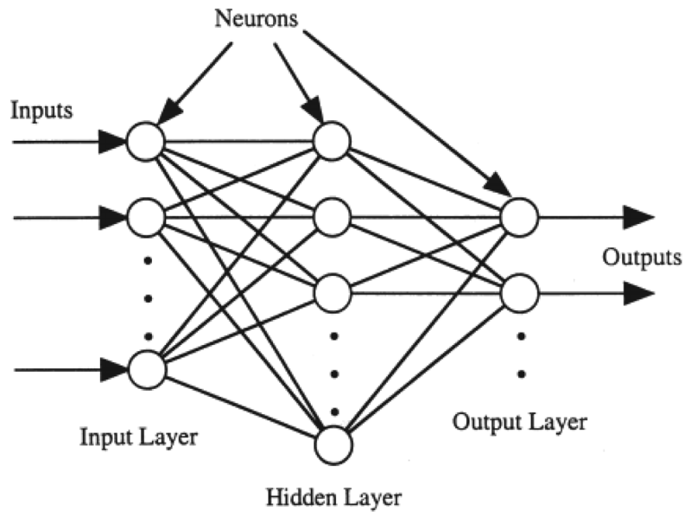

MNIST and Fully-Connected
784 * 800 + 800 * 10 =
635,000 weights
784 800 10
Notes:
Even with MNIST, we can get in the order of 97% classification if we use a FC neural network with one hidden layer of size 800.
We do the math and we have 635,000 parameters- that’s large, but with respect to the fact that our laptops can now do something in the order of 2-3 billion operations a second, that’s pretty acceptable and can easily be trained.

Slide 8


Images and Fully-Connected
90,000 dimensional vector!
Min.
8 billion weights!
Notes:
Now let’s say we want to make a network that distinguishes between dogs and cats in a photo.
To make things a little easier, we add a preprocessing step to all our photos that makes sure our images are 300x300 in size.
This introduces a complication. We’ll first vectorize our image like we vectorized MNIST, yielding a 90,000 dim vector.
Then we’d need at least one hidden layer to do this operation!
Now in the last example we used a hidden layer of greater or equal size to the input.
This seems to increase the accuracy of the network.
If we did something similar in this case we’d have to deal with 8 billion weights! That would mean lowerbound the operation would take 3-4 seconds on a modern laptop, and likely require more time. Even then, we’d still probably need more hidden layers to actually compute anything relevant.
Clearly this is extremely limiting

Slide 9
Vectorizing Images
Help!
Where Am I?
Notes:
Now there’s one detail I also brushed over when talking about the problems of fully-connected networks
Information loss when we vectorize.
As you can imagine, we lose the spatial information that is encoded in images.
Pixels that are right next to each other in a 2d image will be much further from each other in the vectorization

Slide 10
Pitfalls of Fully-Connected Layers
Require way too many parameters to attack large dimensional problems
Data loses spatial representation
Notes:
To sum everything up

Slide 11
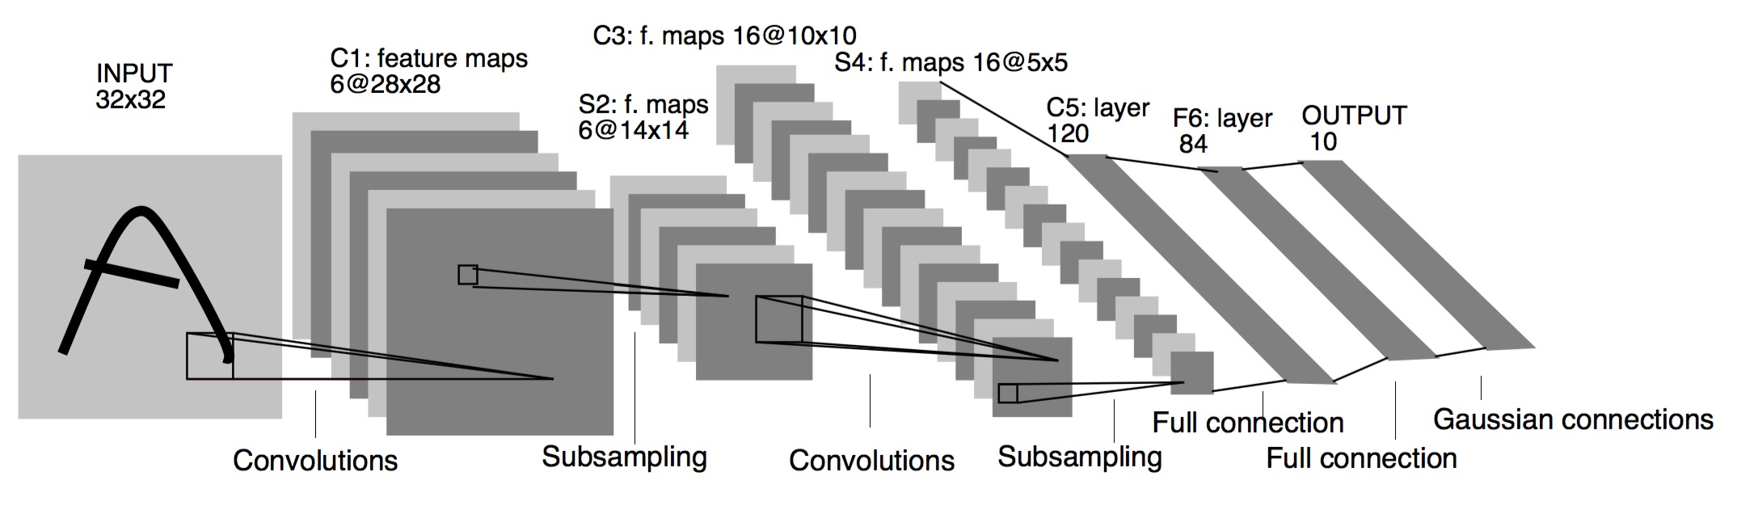
Where do we look??
Convolutional Layers!
Image source

Slide 12
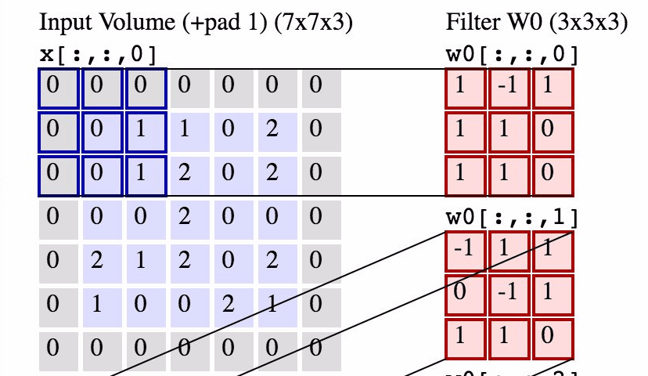
What is a convolution?
Image source
Notes:
So what is a convolution?
I’m glad you asked?
You can basically think of it like a scan.
We take a small set of weights called a filter,
Run it over an array and at each position that it lands,
take the dot product of the filter and the
Values it goes over. These accumulate in what is called the output volume

Slide 13
Key features of the Convolutional Layer
Has multiple filters for each layer
Output is not flat
Typical input is also not flat
Images are in fact 3D – think RGB
Demo
Notes:
So there are a few caveats that are not immediately apparent with Conv Layers
So each Conv layer actually has multiple filters –
this means that the output of each layer is not a flat 2Darray, but rather in 3D.
But you should also note that the input is usually not flat either
Color images are in fact 3D – think the different intensities necessary for RGB
But with this in mind, the filter will span the entire “depth” of the input volume
– for images this means that a filter will extend through all of the RGB channels

Slide 14
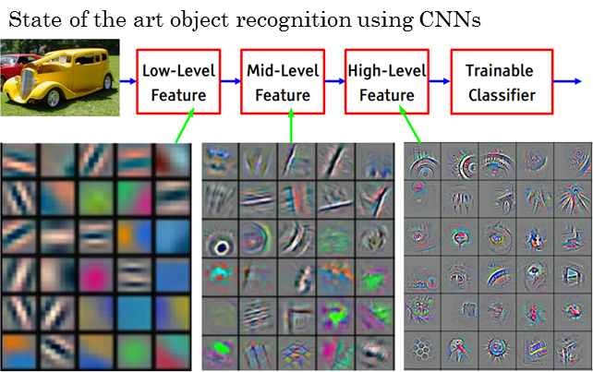
Key features of the Convolutional Layer
Has multiple filters for each layer
Output is not flat
Typical input is also not flat
Images are in fact 3D – think RGB
Demo
Image source
Notes:
So there are a few caveats that are not immediately apparent with Conv Layers
So each Conv layer actually has multiple filters –
this means that the output of each layer is not a flat 2Darray, but rather in 3D.
But you should also note that the input is usually not flat either
Color images are in fact 3D – think the different intensities necessary for RGB
But with this in mind, the filter will span the entire “depth” of the input volume
– for images this means that a filter will extend through all of the RGB channels

Slide 15
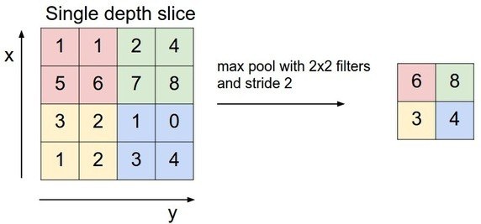
Pooling Layer
Similar to the convolution, but takes a summary operation for each depth slice instead of the dot product
Downsamples the image
Bins features
More talk here and image source
Notes:
And with convolutional neural networks we’ll also include another type of layer called a pooling layer.
This basically takes the summary of a filter instead of the dot product – also does it for each depth slice

Slide 16
CNN Resources
https://ujjwalkarn.me/2016/08/11/intuitive-explanation-convnets/
http://colah.github.io/posts/2014-07-Conv-Nets-Modular/
http://neuralnetworksanddeeplearning.com/chap6.html
Notes:
Now this was a lot to throw at you guys, but as before I’ve included a list of good resources to go over and try to understand what is going on here.

